Slide 1
SCHEDULING in LINUX
Presented By: Bijali Jayalakshmi Jayan

Slide 2
Contents
Introduction
Process Scheduling
Real Time Tasks
Kernel Synchronization
Conclusion

Slide 3
INTRODUCTION
Process
A Program in execution
In Linux, a Process is a running instance of a command. Whenever you issue a command in Linux, it creates, or starts, a new process.
Pre-emptive Scheduling
CPU Scheduling decisions may take place when a process:
Switches from running to waiting state.
Switches from running to ready state (occurs interrupt)
Switches from waiting to ready state (completion of I/O)
Terminates.

Slide 4
SCHEDULING
Scheduling in linux deals with the removal of the current process from the CPU and selecting another process for execution.
Scheduling is not just running and interrupting of user process.
The running of the various kernel tasks is Scheduling in Linux.
Scheduling is two types:
Process Scheduling
Real-Timing Scheduling

Slide 5
Process Scheduling
Linux has two separate Process-scheduling algorithms. One is a time sharing algorithm for fair pre-emptive multitasking between multiple process and other is real-time tasks, where absolute priorities are more important than fairness.
Fast process response time: -low latency.
Maximum system utilization: High throughput

Slide 6
continues
Process Types
Process are in 2 types. They are:
Processor Bound Process
Eg:)Infinite loop, ssh-keygen, MATLAB
I/O Bound Process
Eg) Keyboard, network, disk, mouse etc…

Slide 7
CFS
O(1) Scheduler
Constant time
Time slice calculation & per processor run queues.
Good for large server workload,
But lacks interactive processes.
CFS is Complexity Fair Scheduler.
UNIX favour is a I/O bound process.
Good interactive response & desktop performance, optimizes for process response, thus favouring I/O bound processes over Processor bound process.

Slide 8
continues
Times sharing fair algorithm was introduced in Linux Kernel version 2.6.
CFS introduced a new scheduling algorithm called Fair Scheduling, that eliminates time slicing. Instead of time slices, all Processes are allotted a proportion of processor’s time. CFS calculates how long a process should run as a function of total number of runnable process.
CFS is a significant departure from the traditional UNIX process scheduler.
Process Priority
More the priority more time slice of processor

Slide 9
continues
Linux Priority Ranges
Pre-emptive, Priority-based algorithm with 2 separate priority ranges. These are: Real Time Priority and Nice Value.
Nice Value
-20 to +19
More nice,
Less priority.
In Linux, it is a control over the proportion of time slice.
Smaller nice values indicates higher priorities.

Slide 10
continues
Real Time Priorities
Default (0-99)
Configurable
Opposite from nice value
Real time processes are higher priority than normal processes
Linux implements it in accordance with the relevant UNIX standards.

Slide 11
continues
In earlier day UNIX, the core variables were the priority and time slice.
Linux implements a fair scheduling algorithm.
All processes are allotted a proportion of processor’s time.
CFS calculates how long a process should run as a function of total number of runnable process.
If there are N runnable processes, each process should be allotted 1/N of processor’s time.
This allotment is adjusted by weighting each process’s allotment by its nice value.

Slide 12
continues
Process with default nice value have a weight of 1- their priority is unchanged.
Process with a smaller nice value receives a higher priority.
Process with a larger nice values receive a lower weight.

Slide 13
continues
CFS runs each process for a time slice proportional to the process’s weight divided by the total weight of all runnable processes.
To calculate the actual length of time a process runs
  A configuration variable called Target Latency is used.
  Target Latency is the interval of time during which every runnable task should run at least once.
      Eg)
      Assume that we have 2 runnable processes of the same priorities.
      Each of these processes has the same weight and therefore receive the same proportion of the processor’s time.

Slide 14
continues
  If the target latency is 10 milliseconds, the first process runs for 5 milliseconds and the second process runs for the next 5 milliseconds and so on.
  If there are 10 runnable processes, each process will run for 1 millisecond before repeating.
  If there are 10000 processes, each process can run only for 1 millisecond.
  Switching Costs are involved – Scheduling processes for short lengths of time is inefficient.
  Therefore, another configuration variable called the “Minimum Granularity” is used.
  Minimum granularity is the minimum length of time any process is allotted the processor’s time.

Slide 15
continues
  Regardless of the latency, the process will run for at least the minimum granularity.
  The CFS ensures that the switching costs do not grow unacceptably large when the number of runnable processes becomes too large.
  But fairness is violated.

Slide 16
Process Scheduling in Linux
Any multitasking OS must provide tools to permit scheduling of processes as per the user’s or system’s requirements.
Linux can schedule processes to get executed within next few seconds to next few years.
Once the user has submitted a process directing it to execute at a specified time and specified date in future.
Linux manages to remember the processes to be executed and goes about executing them whenever the time arises without needing any further directions from the user.
For this purpose, Linux use “Cron daemon”.

Slide 17
continues
Cron (stands for chronograph) is a daemon to run schedule tasks.
Cron wakes up every minute and checks schedule tasks in crontab.
Crontab (CRON TABle) is a table which contains the lists of tasks scheduled to run at regular time intervals on the system.
When cron wakes up it checks whether any scheduled job is available for it to execute.
If it is, it executes the job and goes back to sleep again, only to wake up the next minute to once again carry out the check.
This cycle goes on till the system isn’t shut down
The command for cron scheduling are: at and batch

Slide 18
continues
at:-
This command is used to execute the specified Linux command at Future time and date.
Syntax is:
at <time>
at <commands>
^d (press Ctrl+d at the end)
;;Here at offers the keywords like now, noon, midnight, today and tomorrow. It also offers the keywords days, weeks, months and years, can be used with + operator.

Slide 19
continues
OPTIONS | MEANING
-l | For listing the submitted jobs
-r | For removing a submitted jobs
atq | To display all the ‘at’ commands jobs that are scheduled (pending jobs) or currently running.

Slide 20
continues
batch:-
This command is used to execute the specified commands when the system load is light (when CPU becomes nearly free).
Syntax is:
batch
<commands>
^d

Slide 21
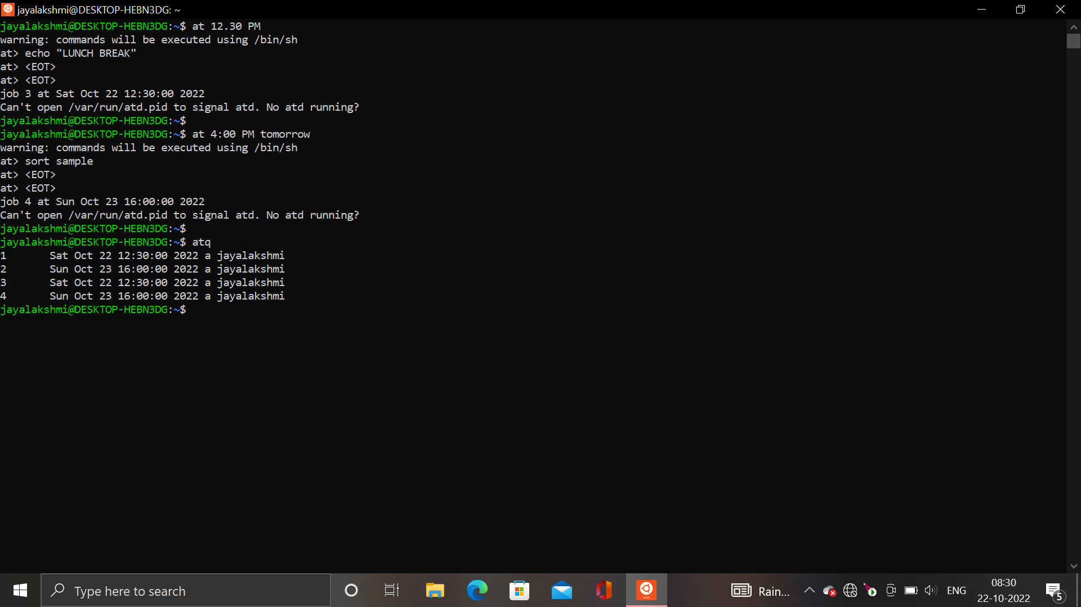
continues

Slide 22
REAL TIME SCHEDULING
Real time systems are systems that carry real time tasks.
Real time tasks can be classified as hard real time tasks and soft real time tasks.
Linux implements 2 real time scheduling classes.
They are: FIFO and RR.
In both cases, each process has a priority has in addition to its scheduling class.
Always the process with the highest priority is run.

Slide 23
continues
Linux’s real time scheduling is soft – rather than hard real time.
The scheduler offers strict guarantees about the relative priorities of real time processes, but the kernel does not offer any guarantees about how quickly a real time process will be scheduled once that process becomes runnable.
In contrast, a hard real time system can guarantee a minimum latency between when a process becomes runnable and when it actually runs.

Slide 24
Kernel Synchronization
A request for kernel-mode execution can occur in two ways:
A running program may request an operating system service, either explicitly via a system call, or implicitly, for example, when a page fault occurs.
A device driver may deliver a hardware interrupt that causes the CPU to start executing a kernel-defined handler for that interrupt.
Kernel synchronization requires a framework that will allow the kernel’s critical sections to run without interruption by another critical section

Slide 25
To avoid performance penalties, Linux’s kernel uses a synchronization architecture that allows long critical sections to run without having interrupts disabled for the critical section’s entire duration
Interrupt service routines are separated into a top half and a bottom half
The top half is a normal interrupt service routine, and runs with recursive interrupts disabled
The bottom half is run, with all interrupts enabled, by a miniature scheduler that ensures that bottom halves never interrupt themselves

Slide 26
3. This architecture is completed by a mechanism for disabling selected bottom halves while executing normal, foreground kernel code.

Slide 27
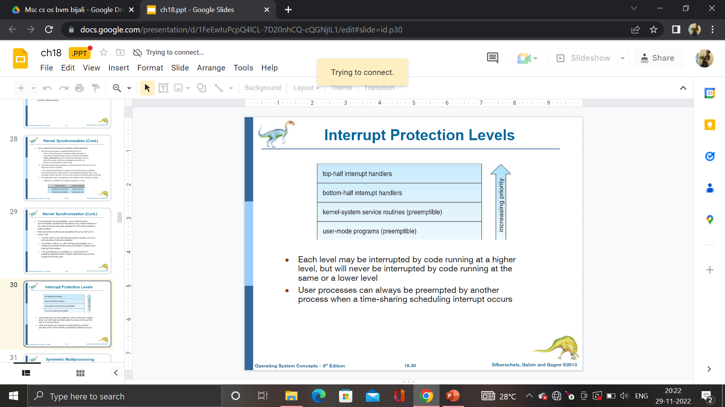
Interrupt Protection Levels

Slide 28
Each level may be interrupted by code running at a higher level, but will never be interrupted by code running at the same or a lower level
User processes can always be preempted by another process when a time-sharing scheduling interrupt occurs

Slide 29
Linux uses two techniques to protect critical sections:
Normal kernel code is non preemptible.
When a time interrupt is received while a process is executing a kernel system service routine, the kernel’s need_resched flag is set so that the scheduler will run once the system call has completed & control is about to be returned to user mode.
The second technique applies to critical sections that occur in an interrupt service routines.
By using the processor’s interrupt control hardware to disable interrupts during a critical section problem, the kernel guarantees that it can proceed without the risk of concurrent access of shared DS.

Slide 30
Provides spin locks, semaphores, and reader-writer versions of both
Behavior modified if on single processor or multi:
SINGLE PROCESSOR | MULTI PROCESSOR
Disable kernel preemption | Acquire spin locks
Enables kernel preemption | Release spin locks

Slide 31
CONCLUSIONS
What does a Scheduler do?
Deciding which process runs next among all runnable processes.
Multitasking OS
Maximize the resource utilization
Good for both I/O bound and CPU-bound processes
Favour I/O-bound over CPU-bound processes
Not starve CPU bounded applications
Reasonably good for Real Time (RT) applications.

Slide 32
Time slice based instead of job based
Priority based scheduling algorithm instead of FCFS schedule higher priority process first
RR for the same priority process
RT processes have higher priorities than those of all normal processes
Pre-emptive instead of non pre-emptive.
Scheduling time as short a possible
The length of time slice and process priority- Interactive processes- CPU- bounded processes- RT processes

Slide 33

END

